Slide 1
The Coleman Art Museum
Group 4
James “Max” Gray
Amy Jones
Courtney Liburd Jessica Pavlik Robert Prindle
Margarita Vorobyeva

Slide 2
A Note to the Board of Trustees:
NewAge Advertising will be presenting a marketing strategy that will focus on addressing the following aspects which we’ve deemed as crucial:
In an attempt to make amends for the reported loss for the third year in a row, pricing and financial concerns and the museum’s once well-respected image, we propose that this will be the final meeting because our recommendations will prove to be the solution you have been looking for.

Slide 3
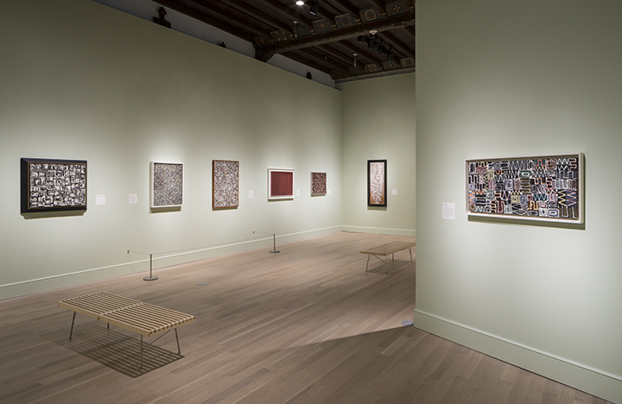
Background Information
Originally founded as Fannel County of Fine Arts in 1925
In 2000, the museum took a name change after Jonathan Coleman.
Now known as Coleman Art Museum
Non-profit organization
Offers guests free admission into the museum
17,429 personal members
60% renew their membership
205 corporate members
85% renew their membership

Slide 4
Industry Background
Most museums across the nation are underfunded from reliable public funds
Only 60% of the over 2000 art museums in the US have the income from their endowment to cover operation costs
CAM is heavily reliant on membership revenues like many other public art museums that chose to operate to the public for free.
Many museums are believed to be owned by wealthy people which can put a negative image around the museum even though they are public.
Museums are beginning to face competition from movie theatres, performance establishments and even receiving pieces of work from artists.

Slide 5
Two Key Challenges
3 consecutive years of lost profit, although visitation is increasing
Government funding is declining
70% of paid memberships do not renew after 1 year
Decline in scheduled events
1)
Museum Image
To the public, CAM has “no image”
Lack of positioning
No known advertisements
2)
“By spanning both art and history, the museum offers a unique perspective on both. On the other hand, a person can only truly appreciate what we have here if they are willing to become historically literate - that is our challenge” - Randall Bren III (Museum Director)
Notes:
Operating at a loss since 2002
2002 net income: -$226,533
2003 net income: -$183,818
2004 net income: -$383,715
Museum Image problem
In the mind of the general public CAM has no image. The building doesn’t elicit the image of a museum nor does it seem inviting to passersby. Many think that it is a bank or office building rather than an art museum. The museum has a great variety of pieces and an excellent mix of Western and non-Western art that is among the best in the country. However, this is not promoted and has created two images of the museum. One is the fact that people don’t know what the museum is or what it offers so it's more of a non-image. The other is a highly educated middle aged group that sees the musuem of a core to the communities cultural activities and is thought of a place of class.
Membership Revenues declining
The regular membership has the highest enrollment, but does not bring in the highest amount of money because the cost of benefits compared with the cost of membership is too high. The membership benefits seen at the basic level need to be reduced or the price needs to be decreased. Only making roughly $8,000 off of 13,000 regular members compared with roughly $150,000 for 2,500 associate level members.
Not enough scheduled events
The amount of scheduled events and special exhibits are declining, though they are among the only areas where a person must pay for them. This means direct revenue for the museum. However, another area of concern is the fact that the cost of putting on events (for insurance) is becoming more expensive.
Less money from Fannel County for 2005
Only expected to receive at most $1.6 from Fannel County compared with $2 million the previous year
Free Admission
The free admission to the museum is great to help bring people in, however, the museum does not have a great or inviting image so people don’t take advantage of it. Also, free admission means less revenue, but charging and entry fee could mean that visitation will decrease which will hurt other areas of the museum revenue like the gift shop, food sales, and special exibit sales.

Slide 6
The BIG Idea
We need to stress the uniqueness that Coleman provides over the competitors.
The Coleman Art Museum is for EVERYONE!
Advertisements (Outdoor)
More general advertising to solidify Coleman’s image
Build awareness about the museum to gain potential memberships
Get in contact with State Tourist Administration and make Coleman a “must-see” attraction
Reach out to local educators to schedule field trips to the museum
Enhance member benefits to retain our customers
$30 annual memberships for students and senior citizens
Notes:
OVERALL: We want Coleman Art Museum to be able to start making a profit, retain their existing memberships & recruit new members.
A problem stated in the Coleman case is that they are finding it harder to get people to visit. Aside from the fact that people at first, must be interested in learning/seeing art/historical pieces. We need a campaign with advertisements that will show the joy and fun in visiting a museum (for students, they may think visiting a museum is boring, so we must change their perspective).
Besides having new pieces, we must show potential customers why they should visit not any museum, but specifically the Coleman Museum. Speaking to the idea that this museum is a historical monument itself for the city might be a good selling point.
Reaching out to local educators will get kids involved. Once they start out young and visit the museum, they will remember their school field trip experience (doesn’t everyone) and will want to go back as they get older to see what is new and what has changed. This will also create a long-term effect in which once they have kids of their own, they will want to bring them to a place they once were.
Add some type of decoration to the outside of the building, since the case stated that the building is almost unrecognizable (looks like a “bank”)
Creating awareness for the museum is a key point, investing into it as a tourist attraction will bring in more people but will also give appeal to locals that this is a place they are lucky to have so close -by since it is such a “must-see” attraction and will therefore want to take advantage of it more with annual memberships

Slide 7
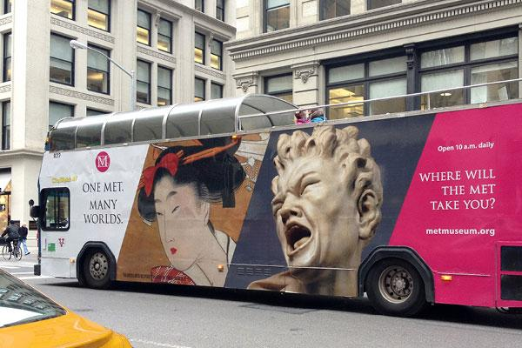
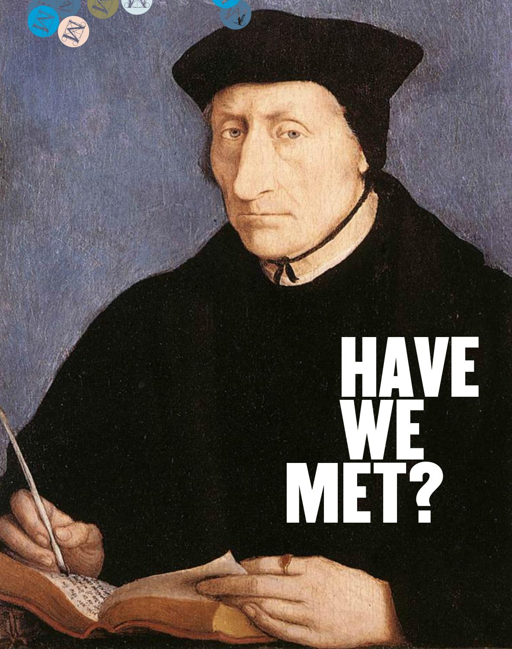
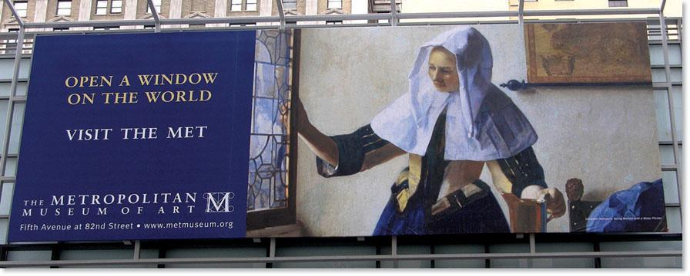
Let’s Give Them Something to Talk About!
Placing light and slightly comical advertisements in the surrounding towns, to draw attention to the CAM as a “must-see” attraction and will keep consumers eager to see what they’ll have next!
Pros | Cons
Competitors are doing it
Bring in awareness to locals and tourists who might otherwise be unaware
Has proven to bring in additional visitations
Cost
Could devalue the museums image
Notes:
Competitors are advertising their permanent collections as well as new/temporary exhibits and we should too!
Using catchy ads we can attract attention to the museum that it is fun and alive (instead of the traditional thinking that museums are boring) - this is a huge obstacle we must overcome.
Positioning TCM as a must visit place with the idea that things are always changing (getting people to consider the annual membership)

Slide 8
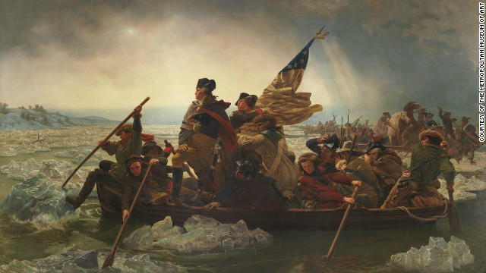
Potential Ad Ideas
Not to worry, The Coleman Art Museum is right around the corner!
Located in the heart of Fannel County with public transportation and parking close by. Best of all, it’s free!
Stir your curiosity.
Stop by today and discover something new!
Are we almost there?!
The Coleman Art Museum
Psssssst!
Remember that school field trip to that local museum you once took with all that stuff?
The Coleman Art Museum
The Coleman Museum is the only museum in Fannel Country that provides a unique experience.
Whether you are an artist, history fanatic, or someone who wants to get the most out of their weekends - there is something for you at the Art Coleman Museum.
Visit today and discover something new!
The Coleman Art Museum
They’ve got new stuff !
Stop by today and discover something new!

Slide 9
Additional Recommendation
Remove the 15 % discount at the Skyline Buffet restaurant and the gift shop
Increase the parking fee to $6.00
Remove the gratis/complimentary memberships
Pros | Cons
An increase in revenue without increasing membership pricing
It stands by the “free” image Coleman takes pride in
Members lose the gratis memberships
Members lose the privilege of discounts
A possibility of decrease in memberships

Slide 10
Rationale For Our Recommendations
By bringing more brand awareness to the CAM, we will drive traffic and thus give people a reason for wanting to visit, locals will see the traffic and want to be apart of the action and will be more likely to purchase annual memberships since there is always something “new” for everyone.
Bringing attention to an “unknown” establishment will bring in more buzz and revenue from new customers
Discounting annual memberships for students and senior citizens will entice them to purchase
By increasing parking fees and removing the 15% discount in gift shops and restaurants, CAM will maintain it’s “free image” while increasing revenue without changing membership fees.
Implementing the $6.00 parking fee will give us about $1,256,949 in additional revenue.
Taking away the Gift Shop & Buffet 15% discount will allow for an $242,330 increase in revenue.
Notes:
-There are 628,472 museum attendees. CAM’s case study states 3 people usually ride in the car. 628,472 / 3 = 209,491 * the $6.00 parking fee is $1,256,949 in additional revenue.
- The gift shop income was $1,596,775. 65% of that was being discounted meaning 35% was not.
1,596,775 * .65 = 1,037,904
1596,775* .35= 558,871
1,221,064 + 558,871 = 1,779,935 the amount spent without the 15% discount.
-$515,843 was the revenue of the Skyline Buffet. By doing the same equation as the Gift Shop $575,031 would be the income if there was no 15% discount.
515,843 *.65 = 335,298
515,843 *.35 = 180,545
394,468 + 180,545 = 575,013

Slide 11
Alternative Solutions and Rationale
Increase restaurant and gift shop discounts and charge non-members a admissions fee.
Do not make any changes. There may be hope in the idea of increased attendance, memberships and revenue raising.

Slide 12
Pros and Cons to Alternatives
Increase restaurant discounts and charge admissions fee: Pros: -Members will enjoy the extra discount in gift shops and restaurants Cons: - Non membership will be discouraged from using the museum due to new fees. - Goes against the museum’s perception of being “free” - Potential decrease in memberships and revenue
-
Do not make any changes: Pros: - The membership prices wouldn’t change. - Their current “image” would remain. Cons: - Endowment earnings would decrease. - Decline in scheduled events. - Lose money for the fourth year in a row. - May ultimately lead to CAM’s closing.

Slide 13
Final Review
We believe that the best course of action for the Coleman Art Museum would be to stress the many benefits that the museum offers and sets it apart from other public museums. This will be done with more creative advertising, enhancing member benefits, working closely with the State Tourist Administration, and partnering with local schools. These will help take the museum out of their current financial situation and allow them to start rebuilding their standing in the community.

